Slide 1
BPEL

Slide 2
BPEL
BPEL stands for Business Process Execution Language.
BPEL is a XML based language that describes business processes flow and provide solution to the process.
BPEL keeps track of all the business processes that are connected to a transaction and ensures that the processes are executed in the correct order.
It is a complete automation process

Slide 3
BPEL Process flow
The BPEL business process receives a request and process the request by using the WSDL (Web Services Description Language).
A BPEL process consists of following steps. Each step is called an activity. These steps include following
receive-receiving the request
    Reply –generating response
    Assign-manipulating data
    Throw-indicating faults and exceptions
    Wait –waiting for some more time
    Terminate –terminate the entire process

Slide 4
..contd
Sequence ( <sequence>), which define a set of activities that will be invoked in an ordered sequence
Flow ( <flow>) for defining a set of activities that will be invoked in parallel
Case-switch construct ( <switch>) for implementing branches
While ( <while>) for defining loops
The ability to select one of a number of alternative paths, using <pick>
Each BPEL process will also declare variables, using <variable> , and define partner links, using <partnerLink>

Slide 5
BPEL process flow
Customer
(BHN)
BHN Adapter
BPEL
Neustar
SOA
new
csr_submitted
csr_successful
lsr_submitted
foc_accept
soa_crt_submitted
soa_pending
soa_activate_submitted
soa_complete
completed
TP

Slide 6
Database used by the BPEL
- SEA DATABASE
SEA_ESR_TRANS
SEA_TXEVENT_HISTORY
BPEL contain following domains
Enterprise
QServices
Preorder
ANQServices

Slide 7
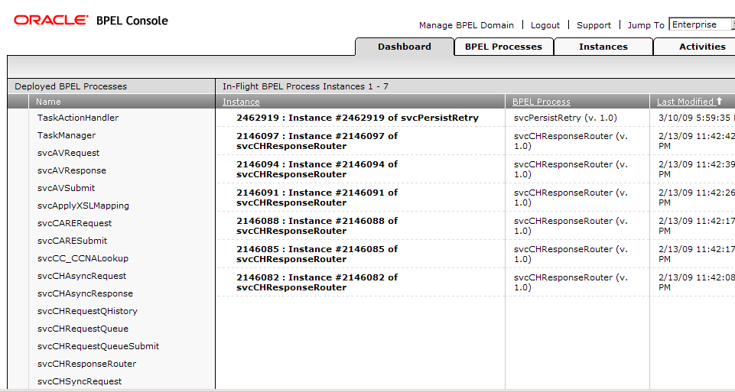
Enterprise-contains info related Process Directors

Slide 8
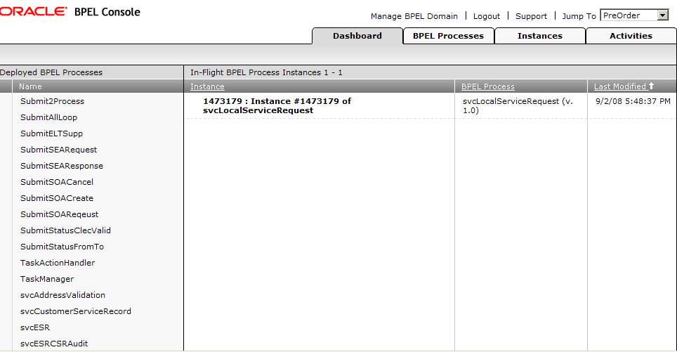
Preorder-contains information related to SOA and LSR orders

Slide 9
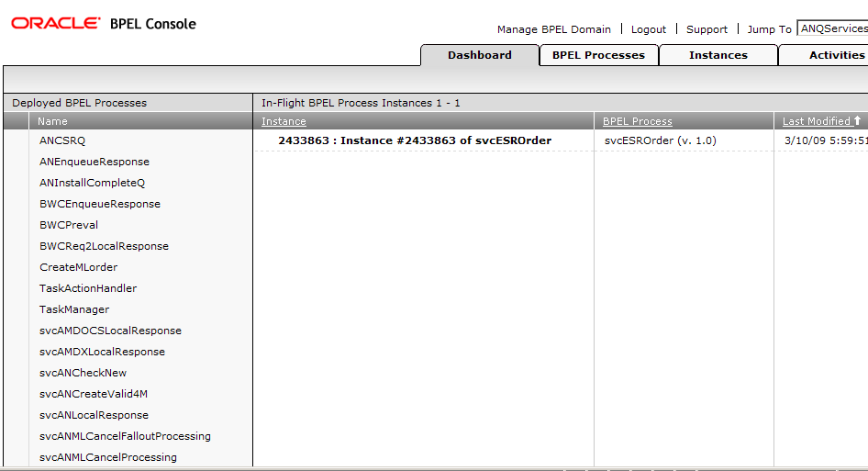
ANQServices-contains information related to responses

Slide 10
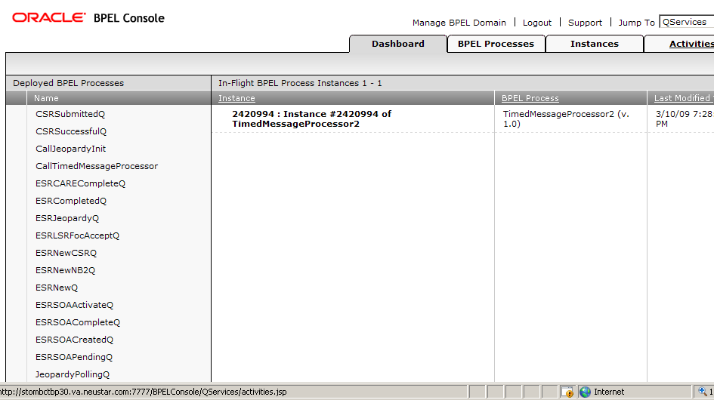
QServices-contains information related to process Q services

Slide 11
Dashboard-it is like platform where services are placed to perform
On the dashboard, there are two services that will be in the loop to call each other.
TimedMessageProcessor2
CallTimedMessageProcessor
TimedMessageProcessor2 will process the records in the timing table.
CallTimedMessageProcessor will wait on the dashboard idle for 2 minutes to call TimedMessageProcessor2 to start up again.

Slide 12
BPEL Processes
Application related instances will be processed here.
Mainly contains
Life Cycle (active/retired)
State (on/off)
Open instances
Closed instances

Slide 13
Instances
Display the overall process of the instances.
If it is processed it will show with green colour)
If it is not processed or if it contains errors it will show in red colour.

Slide 14
Activities
It will display the overall activities with states like open, cancelled, completed, stale(no longer new/aged), all activities with activity label, instance id, process name, created and due

Slide 15
Issues in BPEL
Since it is completely automation process, if anything failed to process that needs to be processed manually.
If customer submitted request through adapter and failed in the validation of the bpel process, it needs to be resubmitted by that customer .
If request is submitted through BPEL GUI it needs to be corrected in the BPEL GUI and needs to be resubmitted. (click on failed Instances-Audit-see red mark –click on that it will open xml request and the correct the request and post deploy the xml)

